Slide 1
Computer Vision Fundamentals
Lecture 1 - Part 4
Digital Image processing

Slide 2
Contents
Aspects of image processing
Image processing task
Types of digital images
Image acquisition
Image perception
Advantages of DIP
Disadvantages of DIP

Slide 3
Aspects of image processing
Image enhancement. This refers to processing an image so that the result is more suitable for a particular application.
  Example include: sharpening or de-blurring an out of focus image, highlighting edges, improving image contrast, or brightening an image, removing noise.
Image restoration. This may be considered as reversing the damage done to an image by a known cause
  For example: removing of blur caused by linear motion, removal of optical distortions, removing periodic interference.
Image segmentation. This involves subdividing an image into constituent parts, or isolating certain aspects of an image.
  For instance, finding lines, circles, or particular shapes in an image, in an aerial photograph, identifying cars, trees, buildings, o

Slide 4
Image Processing Task
Acquiring the image. First we need to produce a digital image from a paper envelope. This an be done using either a CCD camera, or a scanner.
Preprocessing. This is the step taken before the “major” image processing task. The problem here is to perform some basic tasks in order to render the resulting image more suitable for the job to follow. In this case it may involve enhancing the contrast, removing noise, or identifying regions likely to contain the postcode.
Segmentation. Here is where we actually “get” the postcode; in other words we extract from the image that part of it which contains just the postcode.
Representation and description. These terms refer to extracting the particular features which allow us to differentiate between objects. Here we will be looking for curves, holes and corners which allow us to distinguish the different digits which constitute a postcode.
Recognition and interpretation. This means assigning labels to objects based on their descriptors (from the previous step), and assigning meanings to those labels. So we identify particular digits, and we interpret a string of four digits at the end of the address as the postcode.

Slide 5
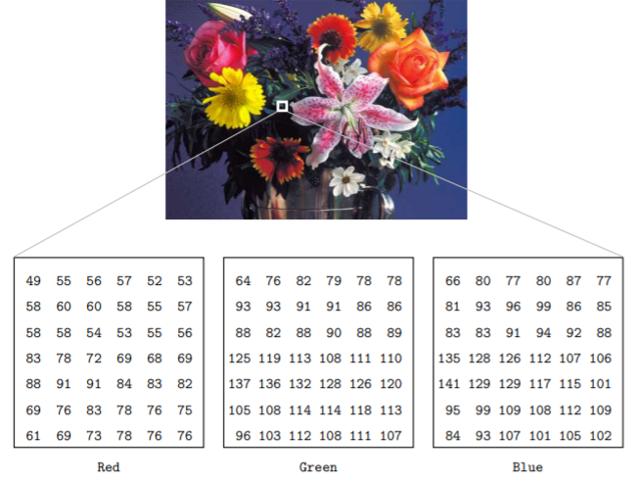
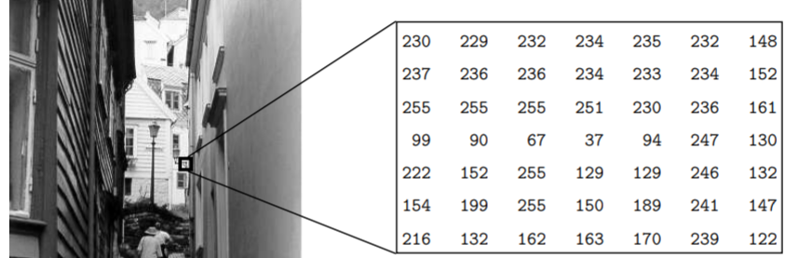
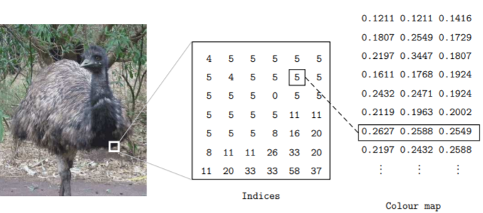
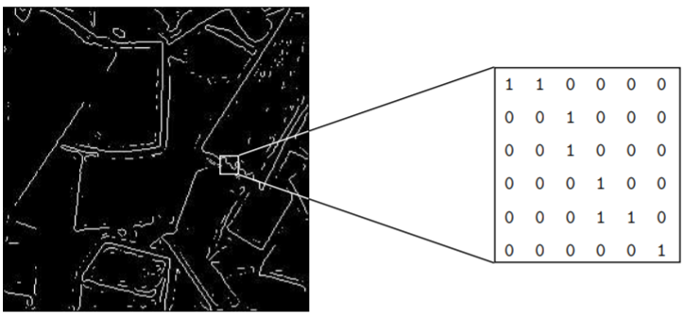
Types of Digital Images (pg. 11)

Slide 6
Image Acquisition
We will briefly discuss means for getting a picture
CCD camera. Such a camera has, in place of the usual film, an array of photosites; these are silicon electronic devices whose voltage output is proportional to the intensity of light
Flatbed scanner. This works on a principle similar to the CCD camera. Instead of the entire image being captured at once on a large array, a single row of photosites is moved across the image, capturing it row-by-row as it moves. Since this is a much slower process than taking a picture with a camera, it is quite reasonable to allow all capture and storage to be processed by suitable software

Slide 7


Image Perception
Image perception consists of two basic steps:
  Capturing the image with the eye
  Recognising and interesting the image with the visual cortex in the brain
Capturing the intensities is the key of image perception

Slide 8
Advantages of DIP
Increased dynamic range
Linear response of images
Availability of post-processing functions
Easy to archive since the images are in digital formats
Leads to a higher patient thorough-put
Separation of image capture processing storage and display processes which mean they can be optimized individually

Slide 9
Disadvantages of DIP
Poorer spatial resolution
Artifacts due to imaging plate, image processing algorithms etc
Non-availability of post-processing functions
Increased sensitivity to scarred radiation
Lack of familiarity to radiologists and radiographers

Slide 10
Thankyou

